Slide 1
SOLID PRINCIPLES
-Prepared by Thati Navya

Slide 2
SOLID PRINCIPLES
Pre Requisite
Why we should learn SOLID Principles?
Introduction
SOLID Acronym
Real time Scenario

Slide 3
Pre Requisite:
OOp's Concepts like inheritance, polymorphism, object, class.. Etc.
Why we should learn SOLID Principles?
"The goal of SOLID Principles is a coding standards that all the developers should have a clear concept for developing software properly to avoid bad design"
"SOLID Principles will help to reduce code complexity, the coupling between classes, separating responsibilities for each class and defining their relations"

Slide 4
Introduction:
In java, SOLID Principles are an object oriented approach that are applied to software structure design
It is conceptualized by Robert C. Martin
These 5 principles have changed the world of oriented programming, also changed the way or writing software
It also ensures that the software is modular, easy to understand, debug and refactor

Slide 5
SOLID Acronym:
S->Single Responsibility Principle (SRP):
O->Open/Closed Principle (OCP):
L->Liskov Substitution Principle (LSP):
I->Interface Segregation Principle (ISP):
D->Dependency Inversion Principle (DIP):

Slide 6
1.Single Responsibility Principle (SRP):
This principle states that
a. A class should have only one reason to change
b. A class should have a single responsibility
or single job or single purpose

Slide 7
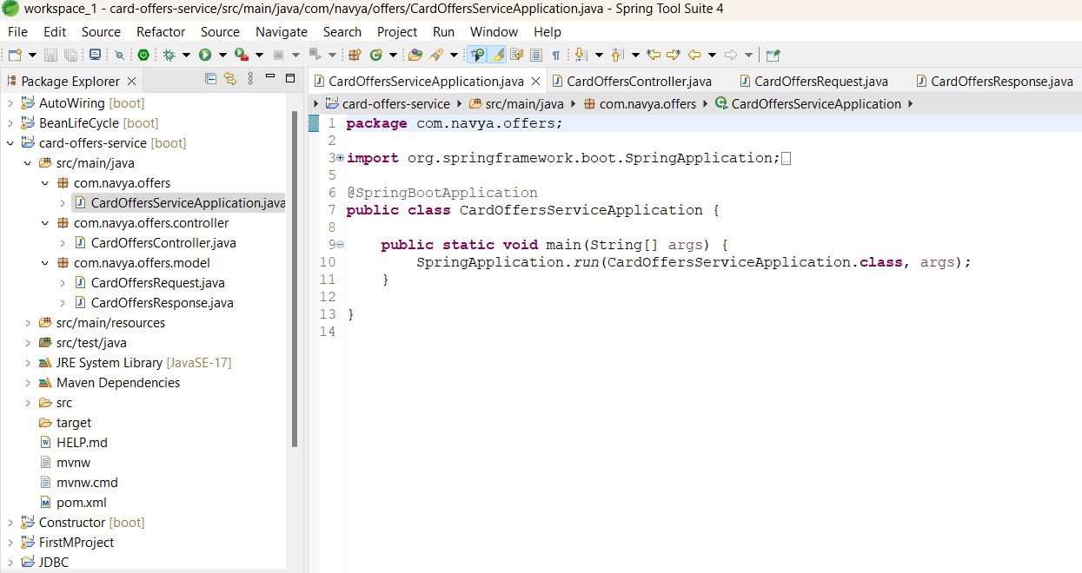
Real time Example

Slide 8
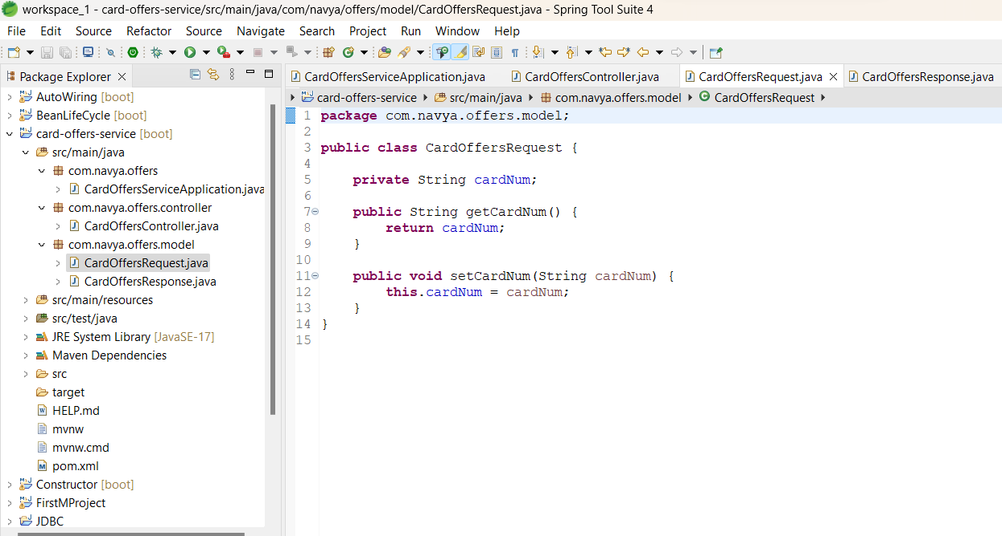

Slide 9
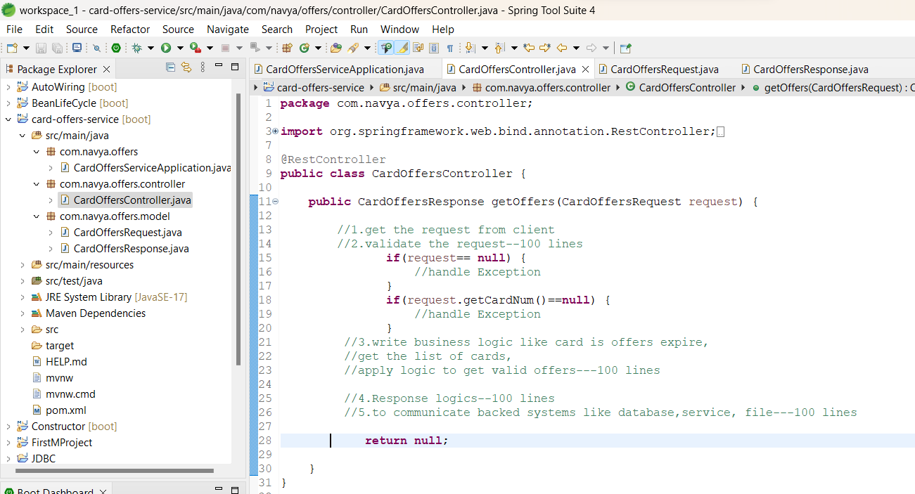

Slide 10
Real time Example:
In single controller class we are implementing all these below features
1.validations
2.business logic
3.calling backend systems
4.request and response preparation
This will impact code readability, code understandability..etc.
So it will violates the SRP
To overcome this problem, split controller class into multiple classes

Slide 11
1.validations -----validator class
2.business logic -----service class
or business class
or process class
or logic class
3.calling backend systems ---DAO class,
Service Client class
4.request and response preparation---RequestBulider class,
ResponseBuilder class

Slide 12
EXAMPLE:
BankServices:
Bank people providing set services like
1.deposit
2.withdraw
3.Get Loans
4.Send OTP

Slide 13
public class BankService{
public long deposit(long amount, String accountNo){
job--//deposit amount
return 0;
}
public long withDraw(long amount, String accountNo){
job--//withdraw amount
return 0;
}

Slide 14
public void getLoanIntrestDetails(String loan Type){
if(“homeLoan”.equals(loanType)){
// write some logic to get the homeloan
}
if("carLoan".equals(loanType)){
// write some logic to get the carLoan
}
if("personal".equals(loanType)){
// write some logic to get the carLoan
}
}
}

Slide 15
public void sendOTP(String medium){
if("email".equals(medium)){
// write email related logic to send email
}
}
This class doesn't follow the SRP because this class has many responsibilities
To achieve SRP then we should implement a separate classes that performs single functionality only

Slide 16
public class LoanService{
public void getLoanIntrestDetails(String loanType){
if("homeLoan".equals(loanType)){
// write some logic to get the homeloan
}
if("carLoan".equals(loanType)){
// write some logic to get the carLoan
}
if("personal".equals(loanType)){
// write some logic to get the carLoan
}
}

Slide 17
public class BankService{
public long deposit(long amount, String accountNo){
job--//deposit amount
return 0;
}
public long withDraw(long amount, String accountNo){
job--//withdraw amount
return 0;
}

Slide 18
2.Open Closed Principle-(OCP):
This Principle states that software entities(classes, functions,modules..etc..) should be open for
extension but closed for modification
i.e. we should able to extend class behavior without modifying existing code.
example:
public class NotificationService{
public void sendOTP(String medium){
1.send OTP via SMS
if("SMS". equals(medium){
// write SMS related logic using one of the java SMS provider Api
}
2.send OTP via email
if("email". equals(medium){
// write email related logic using java mail api
}
}

Slide 19
Problem Statement:
Current logic will send notification via email, SMS but in future if we want send notifications via WhatsApp then we need to modify source code in NotificationService
To overcome this problems, We will go for Open Closed Principle-(OCP)
i.e. “Open for extension but closed for modification”
(It is not recommended to modify the NotificationService for each OTP feature,
it will violate OCP)
Solution:
To overcome this we need to design our code in such a way that everyone can reuse your feature by just extending it and if the need any customization they can extend it and their feature on top of it

Slide 20
public interface NotificationService{
public void sendOTP(String medium);
}
1.Email Notification
public class EmailNotification implements NotificationService{
public void sendOTP(String medium){
//write logic using java mail api
}
}
2.Mobile Notification
public class MobileNotification impelements NotificationService{
public void sendOTP(String medium){
//write logic for MobileNotification
}
}

Slide 21
3.Liskov Substitution Principle-(LSP):
This principle states that "Derived or child classes" must be substitutable for their base or parent classes"
i.e. If class A is child class of class B, then we should able replace B with A without interrupting the behavior of the program
class B{ class A extends B{
} }
B b = new A();(parent class can hold child class obj)
A a = new B(); (child class can hold parent class obj)

Slide 22
Example 1:
public abstract class SocialMedia{
public abstract void chatWithFriend();
public abstract void groupVideoCalls();
public abstract void publishPosts();
public abstract void sendPhotosAndVideos();
}
Some of the Social medias are Facebook, WhatsApp, Instagram

Slide 23
public class Facebook extends SocialMedia{
public abstract void chatWithFriend(){
//chatting logic
}
public abstract void groupVideoCalls(){
//groupVideoCalls logic
}
public abstract void publishPosts(){
// publishPosts logic
}
public abstract void sendPhotosAndVideos(){
//sendPhotosAndVideos logic
}
}
SocialMedia sm = new Facebook();

Slide 24
public class Whatsapp extends SocialMedia{
public abstract void chatWithFriend(){
//chatting logic
}
public abstract void groupVideoCalls(){
//groupVideoCalls logic
}
public abstract void publishPosts(){
// Not applicable
}
public abstract void sendPhotosAndVideos(){
//sendPhotosAndVideos logic
}
}
SocialMedia sm = new Whatsapp();
because WhatsApp doesn't support upload publishposts
Because WhatsApp doesn't support upload publish posts for friends, it just for chatting only

Slide 25
NOTE:
Similarly Instagram doesn't support groupVideoCall() feature so we say Instagram child is not Substitute of parent SocialMedia
Solution:
To overcome this problem we should write the code as below which follow LSP

Slide 26
public interface SocialMedia{
public abstract void chatWithFriend();
public abstract void sendPhotosAndVideos(Object post);
}
public interface SocialPostManager{
public abstract void publishPosts();
}
public interface VideoCallManager{
public abstract void groupVideoCalls(String[] users);
}

Slide 27
NOTE: We have segregate specific functionality to seperate classes to follow LSP
public class Facebook implements SocialMedia, SocialPostManager, VideoCallManager{
// write implementation for all the features
}
public class Whatsapp implements SocialMedia, VideoCallManager{
// write implementation for all the features
}
public class Instagram implements SocialMedia, SocialPostManager{
// write implementation for all the features
}

Slide 28
Advantages of LSP:
1.Code Reusability
2.Easier Maintenance
3.Reduced Coupling

Slide 29
4.Interface Segregation Principle-(ISP):
->No client should be forced to depend on methods that it deos not use
Problem Statements:
->Polluting the interface in project development
Ex: public interface Animal{
func fly()
func eat()
}
interface Flyable{ interface Feadable{
func fly() func eat();
} }

Slide 30
Example:
public interface CardOffers{
public void getRewardPointsAsCreditBalance();
public void getCashBackAsCreditBalance();
public void getCreditHistory();
public void doPayments();
}
public interface CreditCardOffers{
public void getRewardPointsAsCreditBalance();
public void getCashBackAsCreditBalance();
public void getCreditHistory();
}
public interface DebitCardOffers{
public void getRewardPointsAsCreditBalance();
public void doPayments();
}

Slide 31
Example 3:
public interface UPIPayments{
public void payMoney();
public void getScratchCard();
public void getCashBackAsCreditBalance();
}
Problem Statement:
Google pay supports all the above features and this can be implement UPIPayments interface but paytm doesn't support getCashBackAsCreditBalance() feature, so here we shouldn't force paytm client to override this method by implementing UPIPayment interface
UPIPayments are google pay and paytm

Slide 32
Solution:
We need to segregate interface based on client need, so it support ISP we can design something like below
public interface UPIPayments{
public void payMoney();
public void getScratchCard();
}
public interface CashBackManager{
public void getCashBackAsCreditBalance();
}
This ISP Principle states that we should split our interfaces into smaller and more specific ones
ISP, ask you to create a different interfaces for different responsibilities
i.e. don't group unrelated behavior in one interface, we should break if we have already an interface with many responsibilities and the implementor doesn't need all this stuff.

Slide 33
5.Dependency Inversion Principle (DIP):
This Principle states that we must use abstract classes and interfaces instead of concrete implementation.
Problem Statement:
We will goto Shopping mall to buy something, and we decide to pray for it using card.
When we will give card to check for making the payment, that clerk guy doesn't bother to check what kind of card you have given.
Even if we given a debit card of credit card it not even matter, they will simply swipe it.
This is what abstraction between clerk and customer to relay on card processing.

Slide 34
Example:
public class DebitCard{
public void doTransaction(int amount){
System.out.println("txn done with debitcard")
}
}
public class CreditCard{
public void doTransaction(int amount){
System.out.println("txn done with creditcard")
}
}

Slide 35
5.Dependency Inversion Principle (DIP):
This Principle states that we must use abstract classes and interfaces instead of concrete implementation.
Problem Statement:
We will goto Shopping mall to buy something, and we decide to pray for it using card.
When we will give card to check for making the payment, that clerk guy doesn't bother to check what kind of card you have given.
Even if we given a debit card of credit card it not even matter, they will simply swipe it.
This is what abstraction between clerk and customer to relay on card processing.

Slide 36
Example:
public class DebitCard{
public void doTransaction(int amount){
System.out.println("txn done with debitcard")
}
}
public class CreditCard{
public void doTransaction(int amount){
System.out.println("txn done with creditcard")
}
}
Now with these 2 cards customer went shopping mall and purchased some order and decided to pay using creditcard

Slide 37
public class ShoppingMall{
private DebitCard debitCard;
public ShoppingMall(DebitCard debitCard){
this.debitCard =debitCard;
}
public void doPayment(Object order, int amount){
debitCard.doTransaction(amount)
}
public static void main(String[] args){
DebitCard debitCard= new DebitCard()
ShoppingMall shoppingMall= new ShoppingMall(debitCard);
shoppingMall.doPayment("order item name", 10000)
}
}

Slide 38
Note:
If we observe this is wrong design of coding, now shoppingMall is tightly coupled with DebitCard
If user is trying pay the bill using credit card then he will get error like some error in your card
What can we do?
If we remove debitCard from constructor and inject add creditCard in our application, which is not good approach to write code
Now it would tightly coupled with credit card
If we want for DIP we need to design our application in such away that ShoppingMall application should accept any type of card (It shouldn't care whether it is default card or credit card)

Slide 39
To simplify this designing principle we need to write interface called BankCard
public interface BankCards{
public void doTransaction(int amount);
}
public class CreditCard implementsBankCard{
public void doTransaction(int amount){
S.o.p("txn done with creditCard")
}
}
public class DebitCard implementsBankCard{
public void doTransaction(int amount){
S.o.p("txn done with debitCard")
}
}

Slide 40
->Now we need to redesign shoppingmall application code
public class ShoppingMall{
private BankCard bankCard;
public ShoppingMall(BankCard bankCard){
this.bankCard =bankCard;
}
public void doPayment(Object order, int amount){
bankCard.doTransaction(amount)
}
public static void main(String[] args){
BankCard bankCard= new creditCard()
ShoppingMall shoppingMall= new ShoppingMall(bankCard);
shoppingMall.doPayment("order item name", 10000)
}
}
Note:If we observe shopping mall is loosely coupled with BankCard, any type of card process the payment without any impact, which proofs DIP

Slide 41
Summary:
1.SRP: A class should only one responsibility and one reason to chage/modify that class
2.OCP: Open for extension and Closed for modification
i.e. not recommeded to modify the logic for every feature, try to write new class for each feature
3.LSP: A Derived or child classes should be substituable for thier base or parent class
4.ISP: Don't group unrelated behaviour in one interface, we should break/split interface into smaller or more specific one. i.e ask to create different interface for different responsibilities
5.DIP: Use interface or abstract class instead of concrete classes to supply the dependent objects
i.e. high level modules should not dependent on low level module but both depend on the abstraction
i.e. objects should be loosely coupled using interfaces, abstract classes
Don't tighly coupled with concrete classes.

Slide 42
THANK YOU

